Slide 1
PART 8
JOINS

Slide 2
Cardinality
Cardinality means relationship between two tables.
There are three types of relationships—
1 – 1 → one value from table1 matched with one value from table 2
1 -- * → one value from table1 matched with multiple values from table 2
* -- * → multiple values from table1 matched with multiple values from table 2
(1 → one, * → many)

Slide 3
Joins
Joins are used to retrieve data from multiple tables.
Join is a method of combining information from two tables.
There are mainly two types of Joins—
Inner join (matching values)
Outer join (matching + unmatching values)
Left outer join
Right outer join
Full outer join
Cross join
Self join
Syntax—
SELECT colnames,..,..
FROM table1 AS t1
JOIN table2 AS t2
ON condition;

Slide 4
Inner Join
Returns records that have matching values in both tables
A
Rome
Paris
Madras
Berlin
Oslo
Dubai
B
LA
Paris
Vienna
Oslo
London
A +B
Paris
Oslo

Slide 5
Left Outer Join
Returns all records from the left table, and the matched records from the right table
A
Rome
Paris
Madras
Berlin
Oslo
Dubai
A
Rome
Paris
Madras
Berlin
Oslo
Dubai
B
Paris
Oslo
B
LA
Paris
Vienna
Oslo
London

Slide 6
Right Outer Join
Returns all records from the right table, and the matched records from the left table
A
Rome
Paris
Madras
Berlin
Oslo
Dubai
A
Paris
Oslo
B
LA
Paris
Vienna
Oslo
London
B
LA
Paris
Vienna
Oslo
London

Slide 7
Full Outer Join
Returns all records when there is a match in either left or right table
A
Rome
Paris
Madras
Berlin
Oslo
Dubai
A
Rome
Paris
Madras
Berlin
Oslo
Dubai
B
Paris
Oslo
B
LA
Paris
Vienna
Oslo
London
LA
Vienna
London

Slide 8
Cross Join
A CROSS JOIN returns the Cartesian product of the two tables, meaning it combines every row from the first table with every row from the second table.
A
Rome
Rome
Paris
Paris
Berlin
Berlin
B
LA
Paris
A
Rome
Paris
Berlin
B
LA
Paris
LA
Paris
LA
Paris

Slide 9
Self Join
A self join is a special type of join where a table is joined with itself.
This is useful when you have hierarchical data or need to compare rows within the same table
A
Rome
Rome
Rome
Paris
Paris
Paris
Berlin
Berlin
Berlin
A
Rome
Paris
Berlin
A
Rome
Paris
Berlin
Rome
Paris
Berlin
Rome
Paris
Berlin

Slide 10
PRACTICAL IMPLEMENTATION

Slide 11
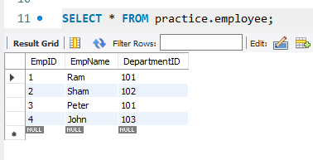
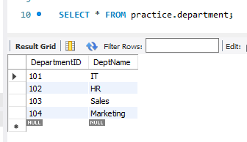
SAMPLE TABLES

Slide 12
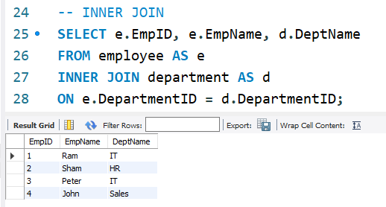
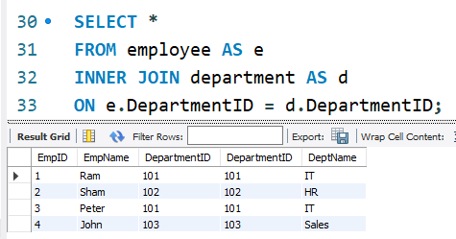

Slide 13
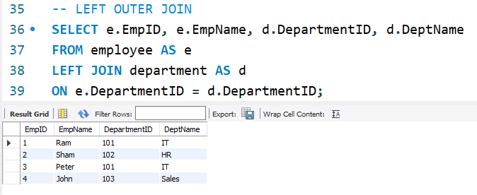

Slide 14
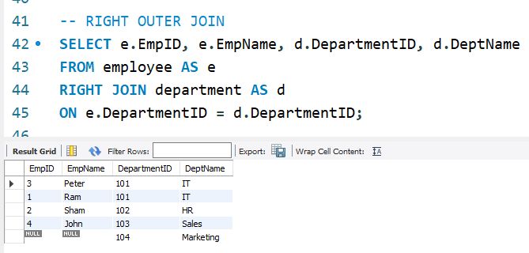

Slide 15
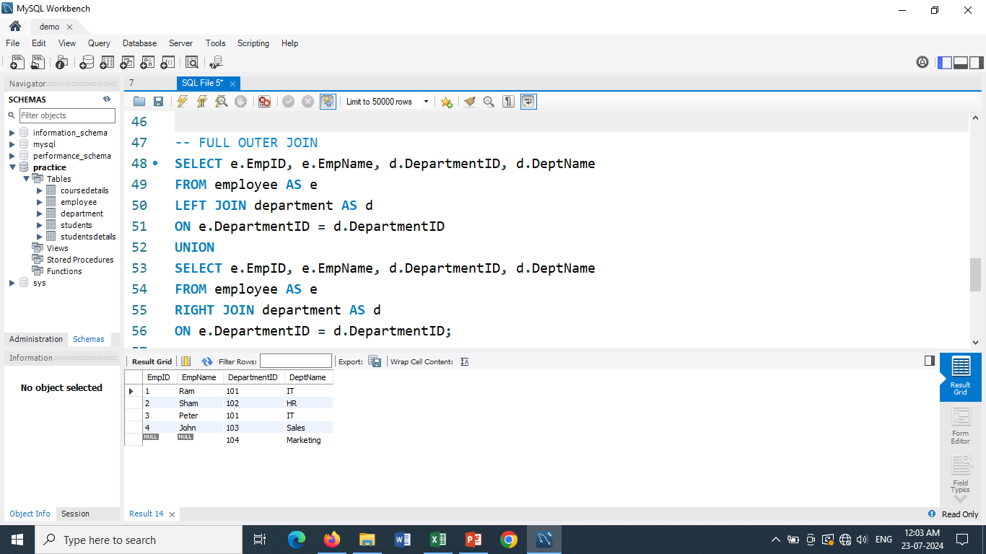

Slide 16
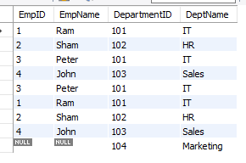
UNION is used to combine the results of two or more SELECT statements into a single result set. It removes duplicate rows by default.
UNION gives following output--
UNION ALL is similar to UNION, but it retains duplicate rows from the combined result sets.
UNION ALL gives following output--

Slide 17
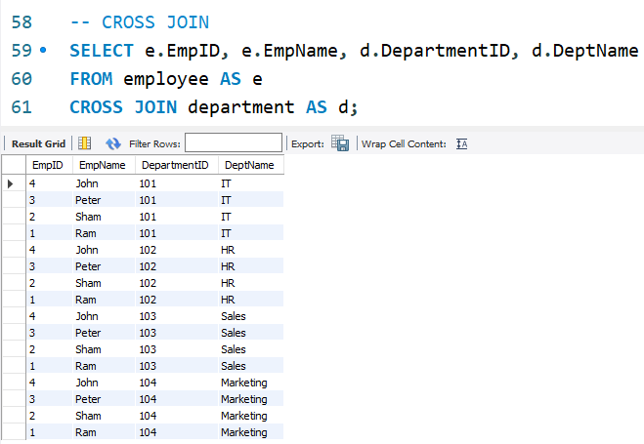

Slide 18
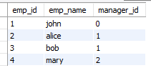
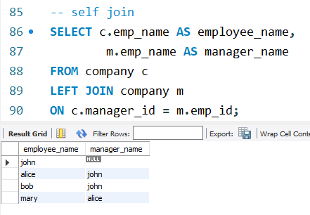
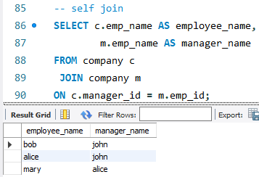
Self Join
Company table

